Slide 1
Topical Analysis Horror Movie Reveiws
Michael Toolin
Natural Language Processing DS 7337-403

Slide 2
Topical Analysis of IMDb Horror Movies
Downloaded the first review of the top 240 horror movies rated on IMDb.
As of April 11, the web scraping technique used in all other homework no longer worked due to changes in IMDb web site. Complete algorithm re-write was required.
Followed the NLP pipeline of preprocessing, vectorizing the text, running different models and then evaluating those models
Notes:
Bayes Classifiers is not a single algorithm, but a set of classfiers
We call it Naïve because we assume all the features being used to classify are independent of each other when they may not be

Slide 3
Text Pre-processing and vectorization
spaCy is used for text cleaning the reviews
Reviews are parsed into parts of speech
Lemmatizer is run to convert words the root lemma
Stop words and punctuation are removed
Remaining words are tokenized
Tokens are vectorized and prepared for analysis
The spaCy default stop words list contains 301 stop words. Earlier assignments showed words “ film, films, movie and movies carried high weight in the feature set. These words provide no insight and were added to the stop word list
** Code provided in Topic-Modeling example used for most of this exercise

Slide 4
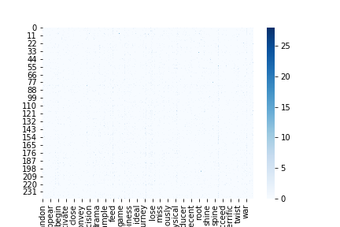
Document- Term Matrix
The Heat map of the document – term matrix doesn’t show any high correlations. The low volume of reviews probably has a lot to do with this.

Slide 5
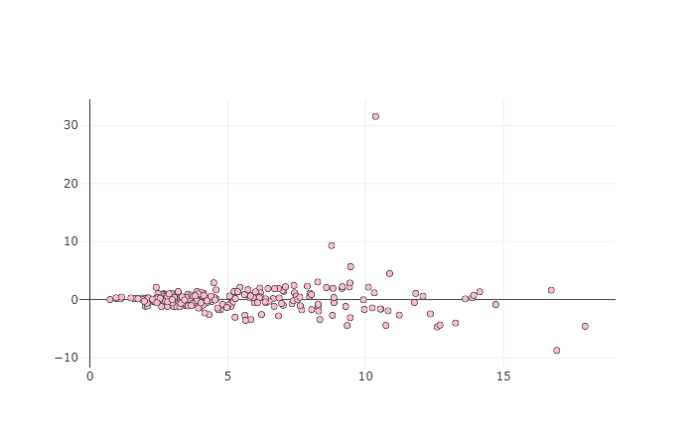
Latent Semantic Indexing
This plot shows the closely words are related. It has been reduced to two dimensions using Singular Value Decomposition (SVD)
With a few exceptions, we can see that our words are closely related. This makes sense as all the reviews are discussing the same genre.
SVD makes drawing any specific conclusions difficult. It usually works well with large volumes of text

Slide 6
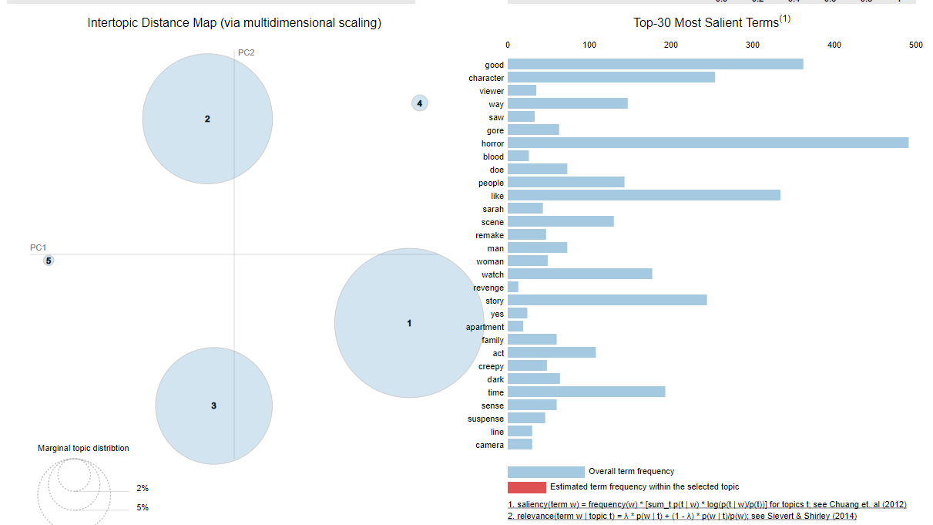
Latent Dirichlet Allocation
LDA analysis provided 3 topics with very relevant terms. Fourth and fifth topics are less relevant.
Cluster Number | % of tokens in cluster
1 | 41.9%
2 | 31.8%
3 | 25.6%
4 | 0.5%
5 | 0.2%

Slide 7
LDA vs NMF
Comparing NMF and LDA modeling, there are many repeat, heavily weighted features between topics in LDA. On the other hand the NMF clustering has separated the topics better with less overlap than seen in LDA
Topic Number | LDA Features | NMF Features
0 | Good, horror, character, like, watch, time, feel, end, story, know | Character, feel, like, think, people, time, little, way, thing, look
1 | Horror, story, like, good, end, time, come, way, feel, character | Sarah, friend, leave, deep, action, run, kill, level, miss, people
2 | Lee, revenge, uncomfortable, portray, viewer, member, realistically, blood, devil, contrast | Horror, come, remake, year, build, happen, gore, scare, family, place
3 | Horror, unease, weight, good, Spanish, like, apartment, gradually, way, story | Water, suicide, dark, scene, Japanese, girl, good, little, begin, open
4 | Horror, like, character, good, think , people, little, thing, story, watch | Good, like, story, watch, time, end, think, death, act, scene

Slide 8
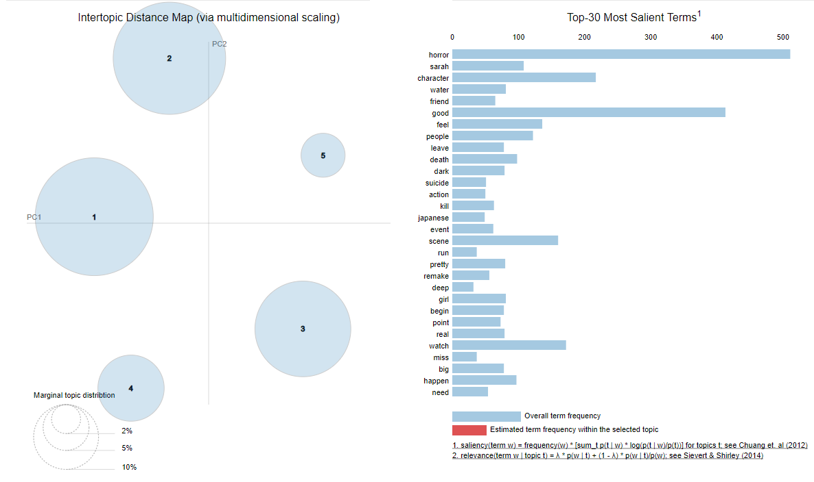
LDA vs NMF topics
LDA
NMF
Here we see NMF creating better topic clusters for the 4th and 5th topics

Slide 9
Conclusions
Cleaning the text of even a small number of key words noticeably effects clustering
Small number of reviews limited the number of truly relevant topics found by either topic analysis algorithms. Although 5 was used, the real number is probably 3.
For this reason, LSI was not able to clearly identify what looks like 1 good cluster
LDA appears to outperform LSI as it clearly identified 3 distinct topics, with a fourth possible that could be applicable
When comparing the terms from NMF and LDA, NMF (which is a form of LDA), NMF created a higher number of more clustered topics
NMF is the recommended algorithm due its performance of creating more topics that have relevant terms.

